Slide 1
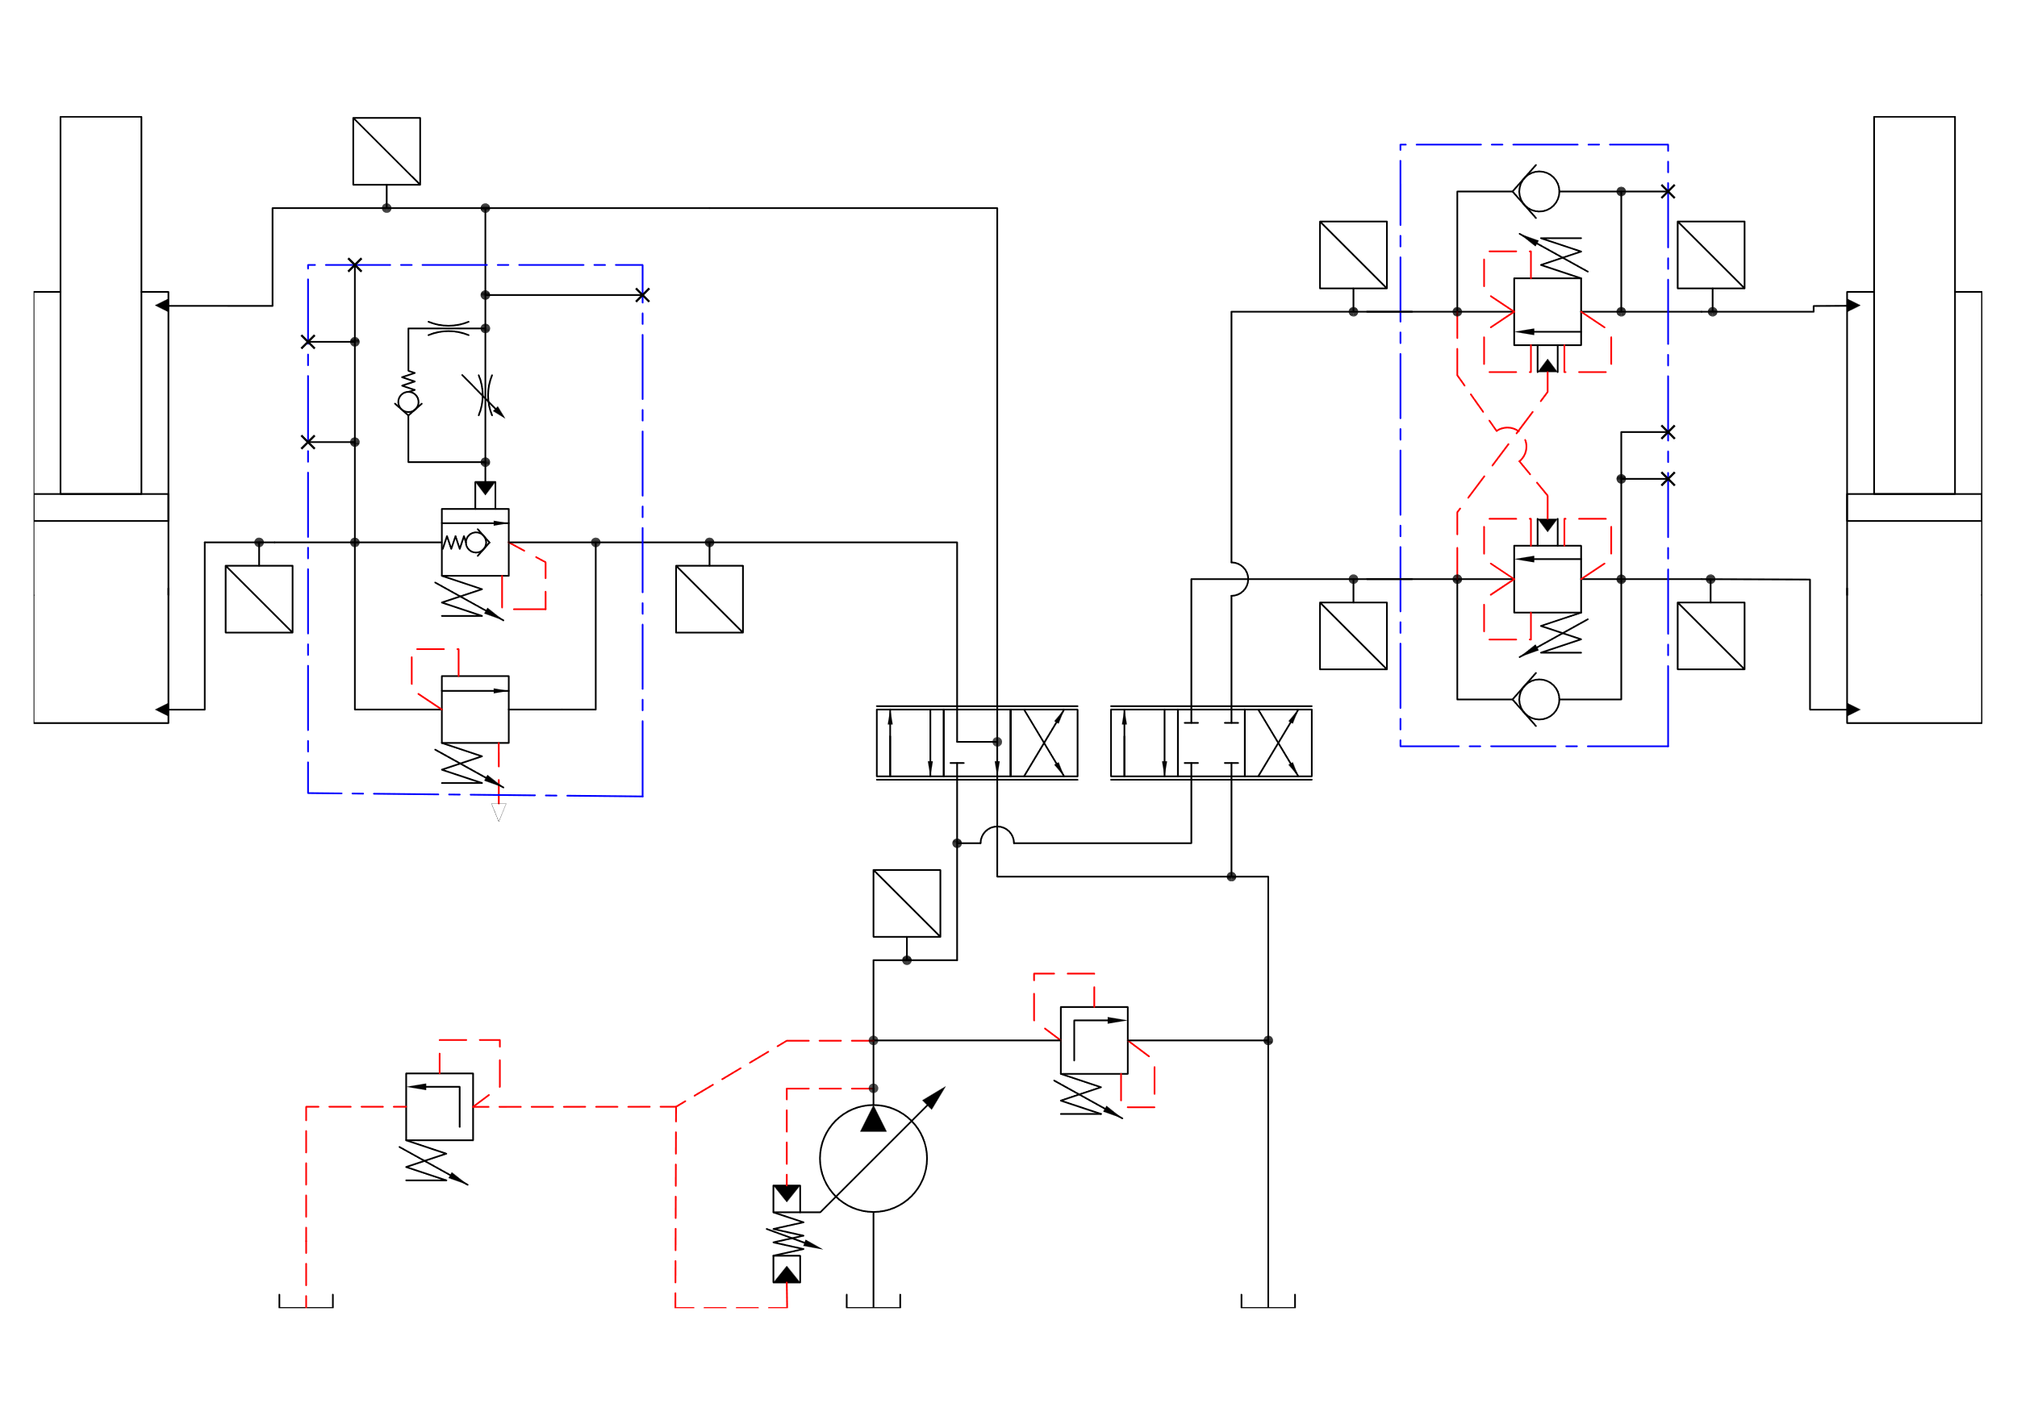
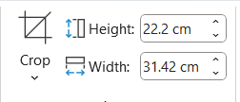
Importing from autocad
Export as pdf from autocad
Convert pdf to svg (https://cloudconvert.com/pdf-to-svg )
Insert svg

Slide 2
U
P
U
U
P
P
U
U
P
P
U
U
P
P
U
P

Slide 3
U
Components
P
U
U
P
P
3
U
U
P
P
U
U
P
P
8
2
1
4
7
U
P
Jib cylinder
Pressure transduser
Jib counter balance valve block
Hawe directional control valve
Hawe directional control valve
Pump
Main counter balance valve block
Main cylinder
6

Slide 4
U
P
U
U
P
P
U
U
P
P
U
U
P
P
U
P

Slide 5
U
Components
P
U
U
P
P
3
U
U
P
P
U
U
P
P
8
2
1
5
4
7
U
P
6

Slide 6
U
Components
P
U
U
P
P
3
U
U
P
P
U
U
P
P
8
2
1
5
4
7
U
P
Jib cylinder
Pressure transduser
Jib counter balance valve block
Hawe directional control valve
Hawe directional control valve
Pump
Main counter balance valve block
Main cylinder
6

Slide 7
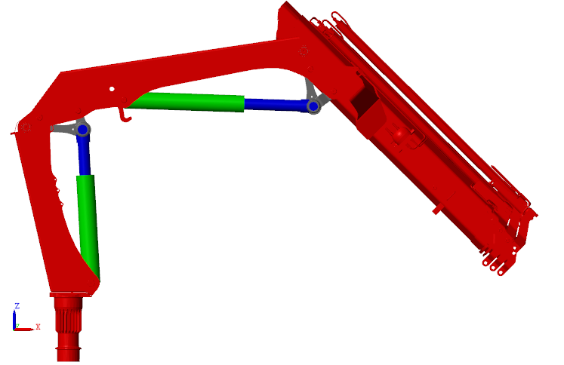
4
3
5
2
Column
Main cylinder
Jib cylinder
Main arm
Jib arm
1

Slide 8
7
U
Sensors
P
1
2
U
U
P
P
9
10
U
U
P
P
U
U
6
5
P
P
4
3
Pb_Jib_DCV
Pb_Jib_Cyl
Pa_Jib_Cyl
Pa_Jib_DCV
Pa_Main_DCV
Pa_Main_Cyl
Pb_Main
P_supply
Stroke_Main_Cyl
Stroke_Jib_Cyl
8
U
P

Slide 9
7
U
TwinCat
P
1
2
U
U
P
P
9
10
U
U
P
P
U
U
6
5
P
P
4
3
Pb_Jib_DCV
Pb_Jib_Cyl
Pa_Jib_Cyl
Pa_Jib_DCV
Pa_Main_DCV
Pa_Main_Cyl
Pb_Main
P_supply
Stroke_Main_Cyl
Stroke_Jib_Cyl
8
U
P

